Slide 1
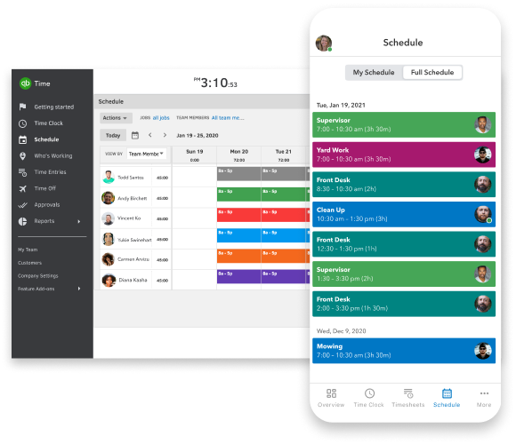
CatchUp
You'll never forget anything again.

Slide 2


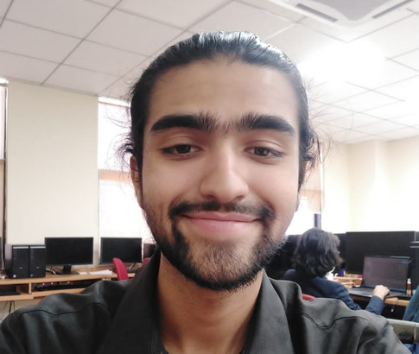



MEET OUR TEAM
Ali Hamza
Musa Haroon
Aiyza Junaid
Muneer Ahmad
Group Lead
Coding Expert
Design and testing expert
Requirement Expert

Slide 3
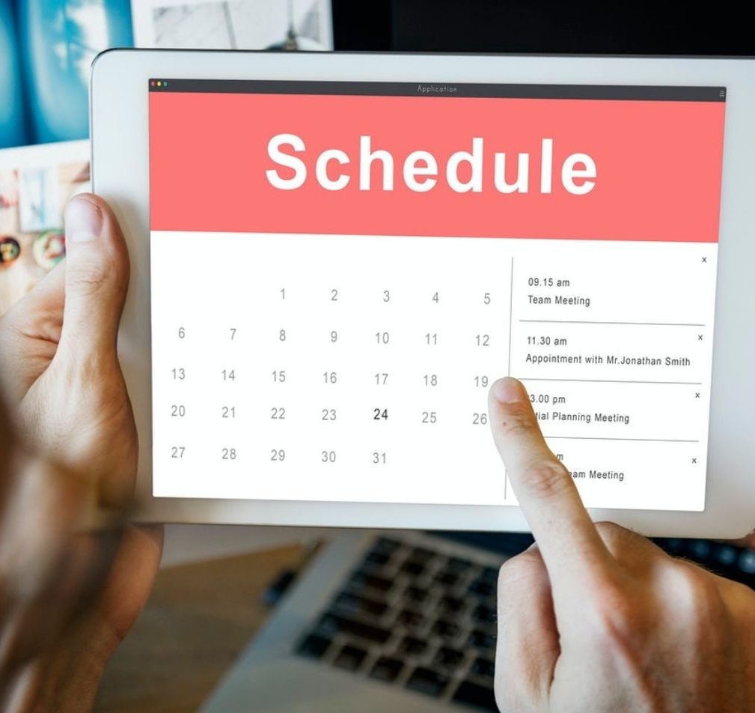
What is CatchUp??
CatchUp will help you manage and track your assignments and quizzes. Our management system will provide you with features that will range from alerting you when a new task is uploaded. It will also sort your schedule for you on the basis of task submission in priority.

Slide 4
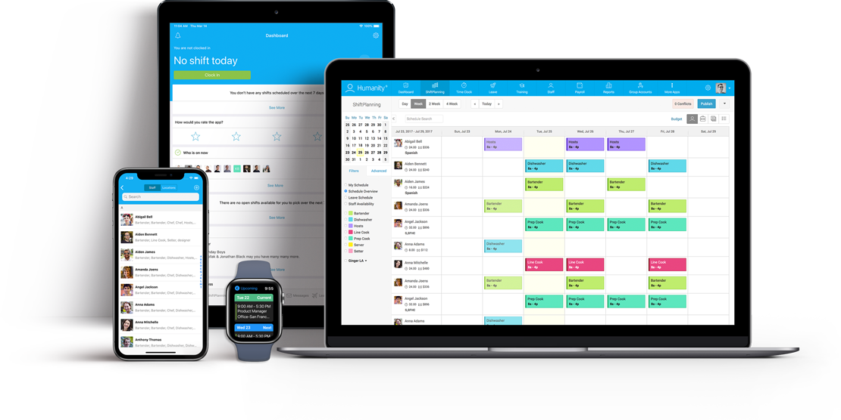
ADVANTAGES
CatchUp will remind your pending assignments and quizzes.
CatchUp will provide a performance graph that you can use to track your progress.
You may also use CatchUp to set reminders for non-academic occasions.
CatchUp can also keep track of your previous academic records for a longer amount of time.

Slide 5

CONSTRAINTS
User must have an up-to-date calendar.
User must have an email address in order to use this application
This application can only be used on a computer with a Windows operating system.

Slide 6
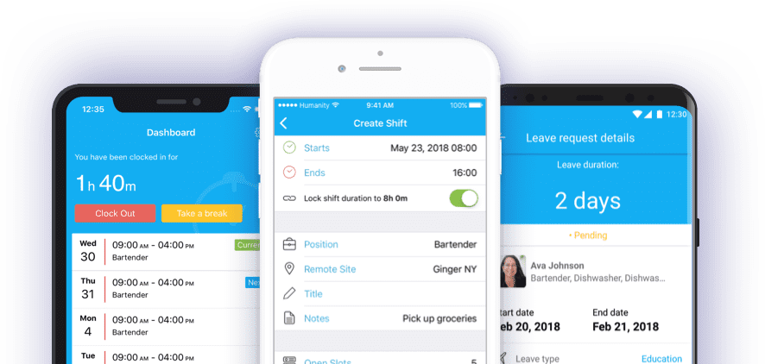
Nonfunctional
Requirements
The dashboard shall display under 5 seconds after user has logged in.
The system would provide access to only legitimate users. It will be secure on network and only authorized person can use it.

Slide 7
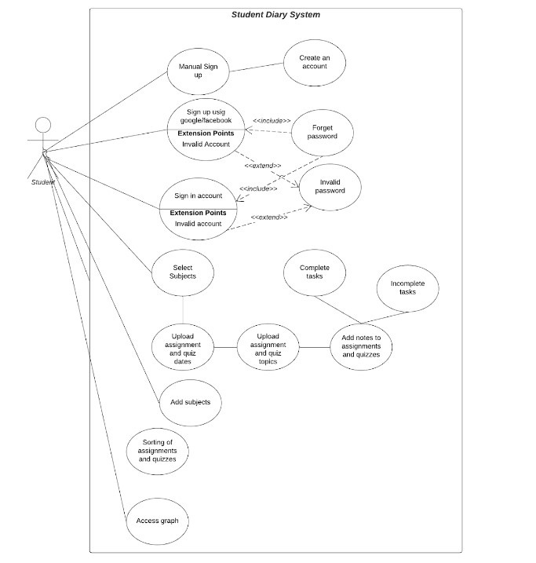
Design
EST 1995
USE CASE DIAGRAM
MADE BY MUNEER AHMAD

Slide 8
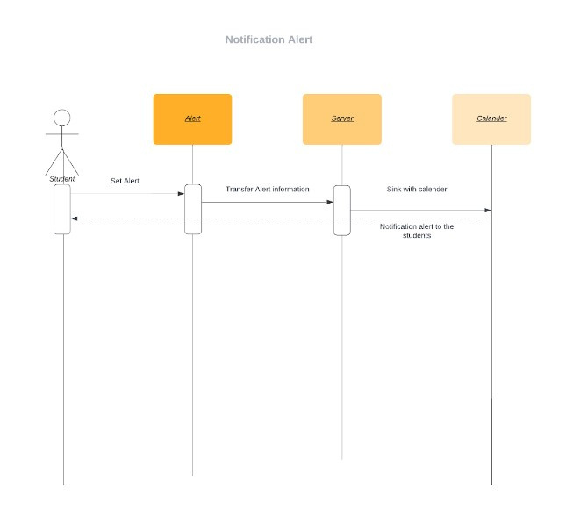
Design
EST 1995
SEQUENCE DIAGRAM
MADE BY ALI HAMZA
*NOTIFICATION ALERT

Slide 9
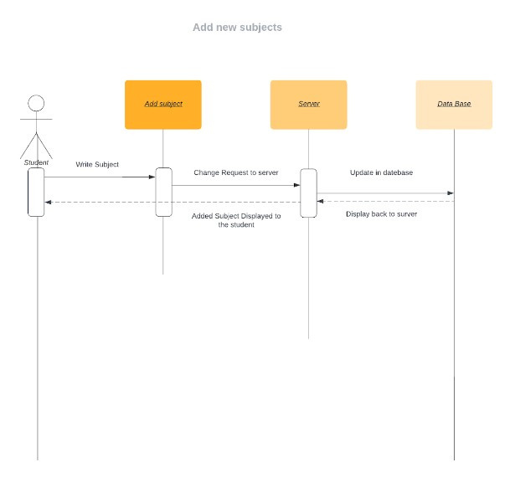
Design
EST 1995
SEQUENCE DIAGRAM
MADE BY ALI HAMZA
*ADD NEW SUBJECT

Slide 10
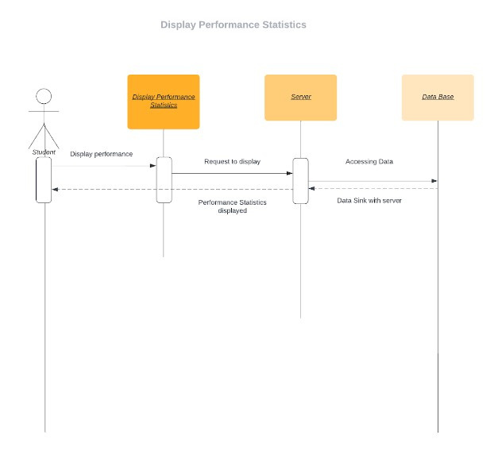
Design
EST 1995
SEQUENCE DIAGRAM
MADE BY ALI HAMZA
*DISPLAY PERFORMANCE STATISTICS

Slide 11
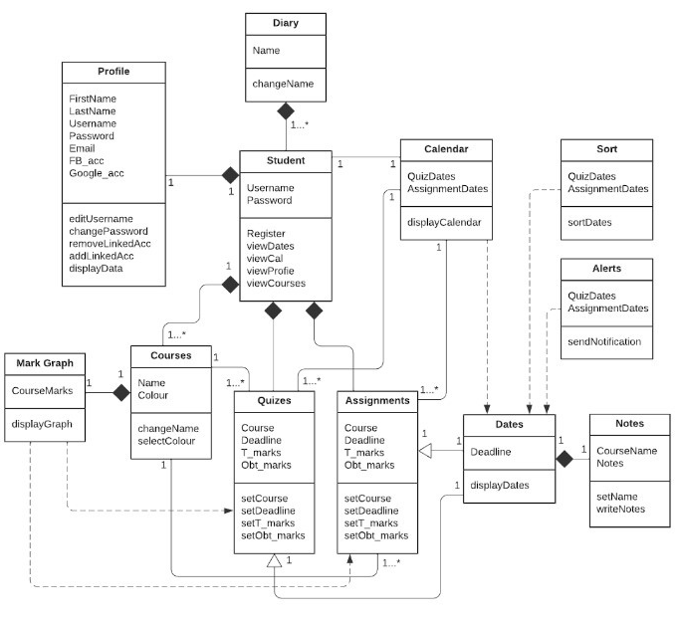
Design
EST 1995
CLASS DIAGRAM
MADE BY MUSA HAROON

Slide 12
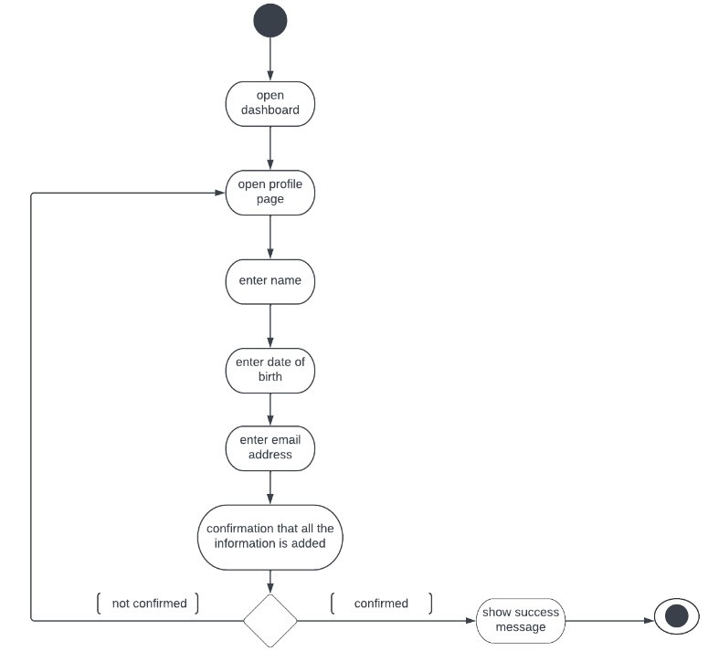
Design
EST 1995
ACTIVITY DIAGRAM
MADE BY AIYZA JUNAID
*ADDING PERSONAL INFORMATION

Slide 13
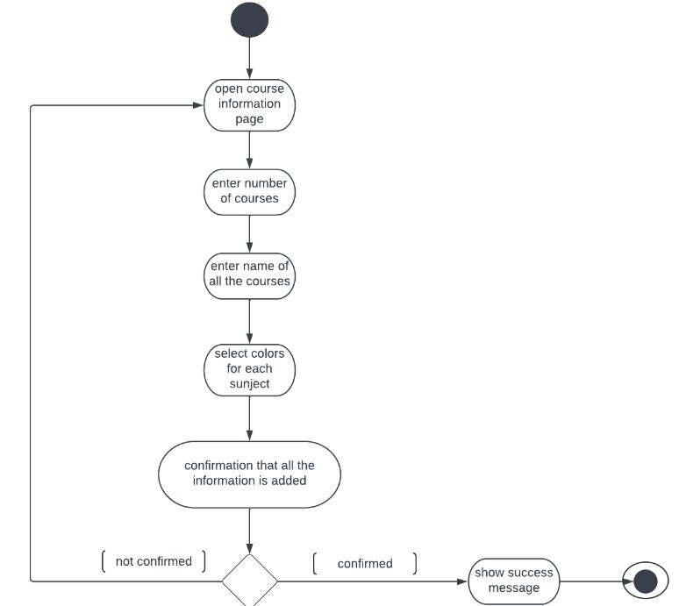
Design
EST 1995
ACTIVITY DIAGRAM
MADE BY AIYZA JUNAID
*ADDING COURSE INFORMATION

Slide 14
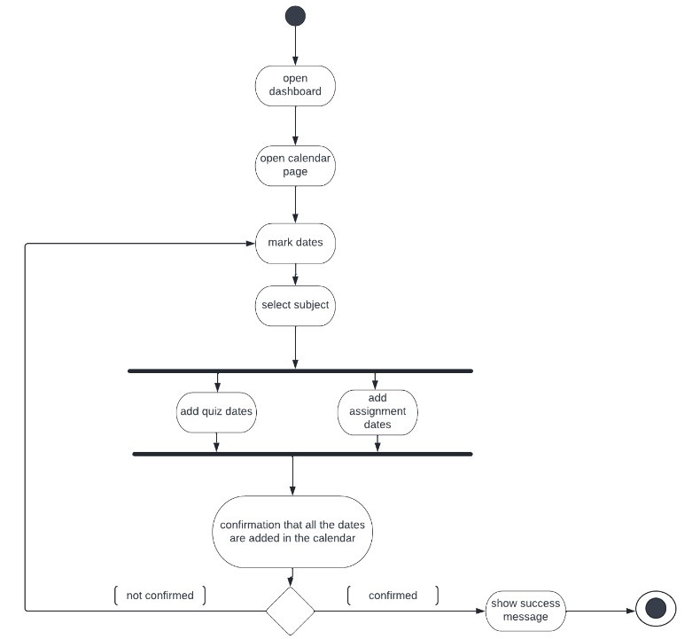
Design
EST 1995
ACTIVITY DIAGRAM
MADE BY AIYZA JUNAID
*ADDING ASSIGNMENTS & QUIZZES DATES IN CALENDER

Slide 15
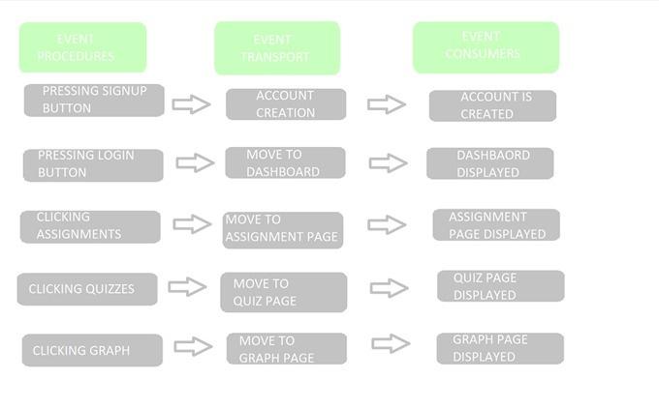
ARCHITECTURE
It is apt for management system that use a date base for data integrity.
It supports reusability and evolution of the system.

Slide 16
Implementation
SCREENSHOTS

Slide 17
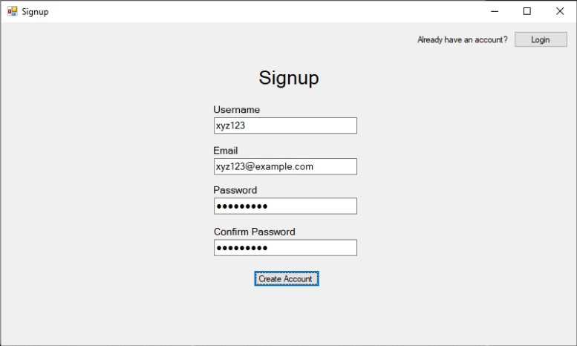
SIGN UP

Slide 18
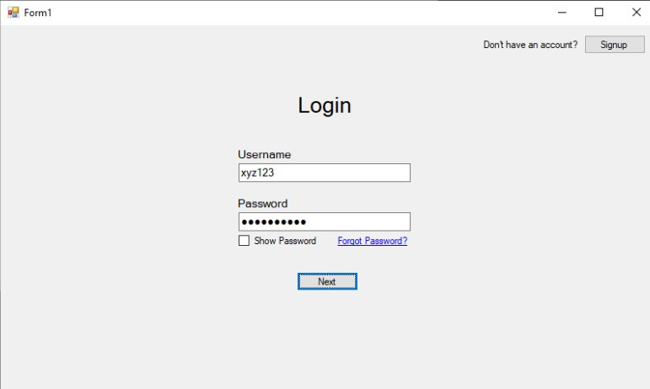
LOGIN PAGE

Slide 19
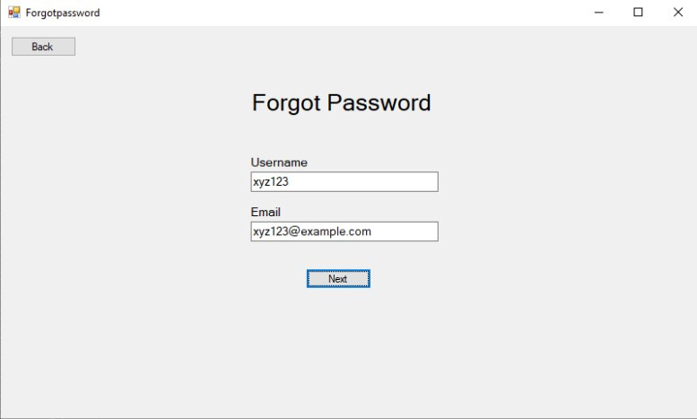
FORGOT PASSWORD

Slide 20
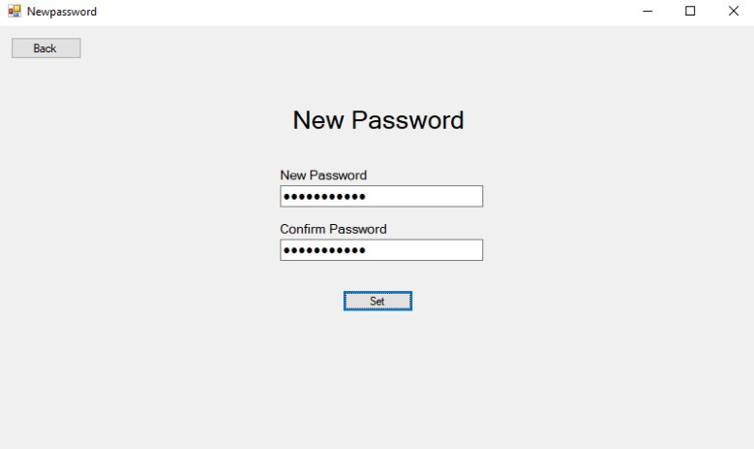
NEW PASSWORD

Slide 21
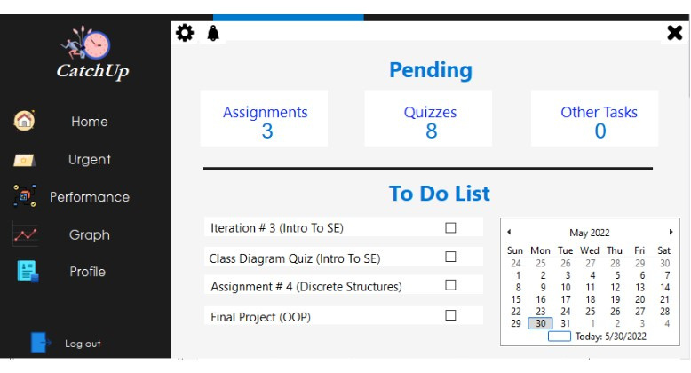
DASHBOARD

Slide 22
WORK DIVISION
ALI HAMZA
MUSA HAROON
Roles division in iteration 0.
5 user stories in each iteration.
Structured requirement specification in Iteration 1.
Sequence diagram in Iteration 2.
Dashboard and logout in Iteration 3.
Presentation slides in Iteration3.
Modular breakdown in iteration 0.
5 user stories in each iteration.
Structured requirement specification in Iteration 1.
Burn Down chart and scrum board.
Class diagram in Iteration 2.
Login/signup/forgot password in Iteration 3.
QuikSleep For a full night's rest

Slide 23
WORK DIVISION
AIYZA JUNAID
MUNEER AHMAD
Features and constraints in iteration 0.
5 user stories in each iteration.
Structured requirement specification in Iteration 1.
Activity diagram in Iteration 2.
Architecture and test cases.
Document compilation in each iteration
Scope and requirements in iteration 0.
5 user stories in each iteration.
Structured requirement specification in Iteration 1.
Use case diagram in Iteration 2.
Final user stories compilation in Iteration 3.
QuikSleep For a full night's rest

Slide 24
THE LESSONS WE'VE LEARNED

Slide 25

FEEL FREE TO ASK QUESTIONS

